Slide 1
Unit 2 Part 2 - MATH OPERATORS
ICS3U/ICS3C

Slide 2
MATH OPERATORS
There are a lot of math operations and calculations available in Java. Here is a list:
http://tutorials.jenkov.com/java/math-operators-and-math-class.html
This has a link to a description of each

Slide 3
MATH OPERATORS
We are going to look at two particularly helpful math operators: round and modulus
Math.round();
This rounds a number to the nearest integer value.
It still wants to store it in a “double” or “long” data type to prevent loss of accuracy

Slide 4

This would store a value of 6.0 in the variable “rounded”

Slide 5

There are two similar operators: Math.ceil();
Math.floor();
What do you think these do? (test the code!)

Slide 6
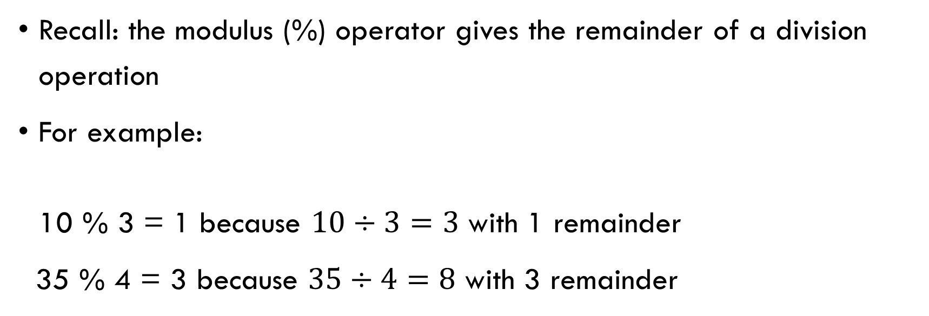
MODULUS OPERATOR (%)

Slide 7
MODULUS OPERATOR (%)
Why is this helpful?
We often will use modulus in programming to have something happen only SOME of the time
To see this, look at the table to see what happens to the following numbers % 4 (remainder when they are each divided by 4)
x | 0 | 1 | 2 | 3 | 4 | 5 | 6 | 7 | 8 | 9 | 10 | 11 | 12
X%4 | 0 | 1 | 2 | 3 | 0 | 1 | 2 | 3 | 0 | 1 | 2 | 3 | 0

Slide 8
MODULUS OPERATOR (%)
We can use this to make something happen only every 4th time something occurs (often in a loop - very useful next unit!) if (x%4==0) { //do this code } this “if” statement will happen only every 4 times, if x is being incremented
x | 0 | 1 | 2 | 3 | 4 | 5 | 6 | 7 | 8 | 9 | 10 | 11 | 12
X%4 | 0 | 1 | 2 | 3 | 0 | 1 | 2 | 3 | 0 | 1 | 2 | 3 | 0

Slide 9
RANDOMS
There are different ways to generate random numbers in Java. There is a function Math.random() which returns a random decimal value from 0 - 0.9999… which you can then multiply, round, etc. to convert to a random integer. If you import the java.util.* package (like for Scanner) you can also use the Random class:

Slide 10

RANDOMS
We have to create a new “random” object (similar to creating a new Scanner but we don’t need the “System.in”)
Then we can use that random object (here, “randNum”) to give us a random integer using the nextInt() command. The “10” indicates that we want a range of 10 numbers (which always starts at zero)

Slide 11
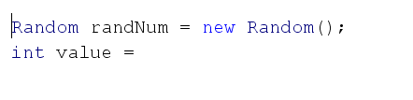
RANDOMS
Random integer from 1-5 (inclusive)
Random integer from 90 to 100 (inclusive)
Random integer from 20 to 35 (inclusive)

